Slide 1
AI Essentials for Business
Gordon Gao

Slide 2
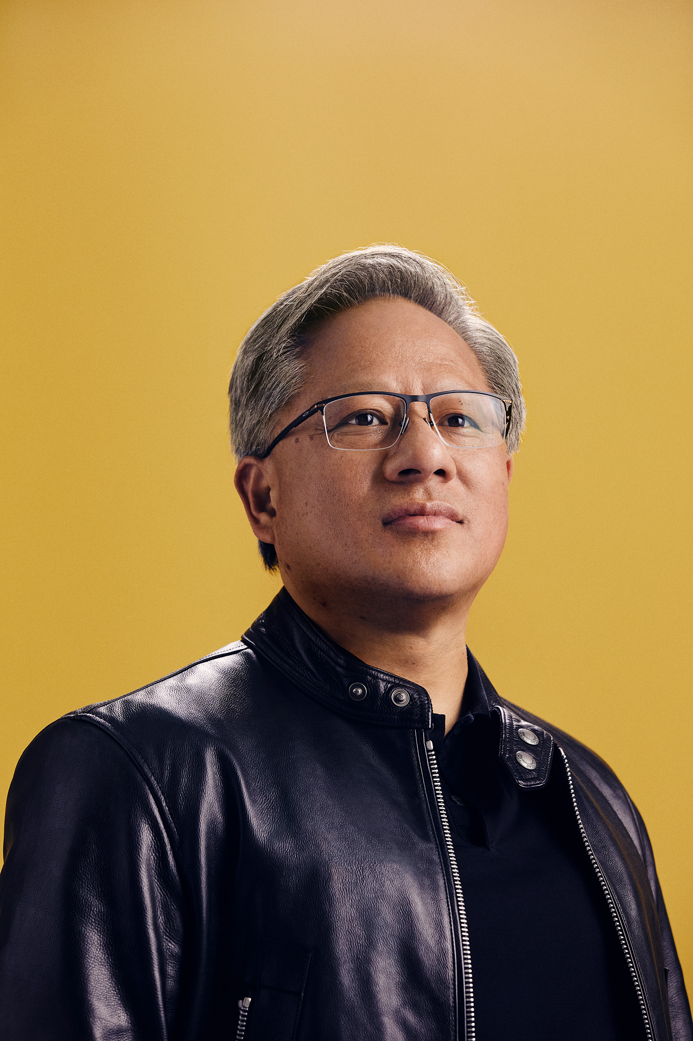
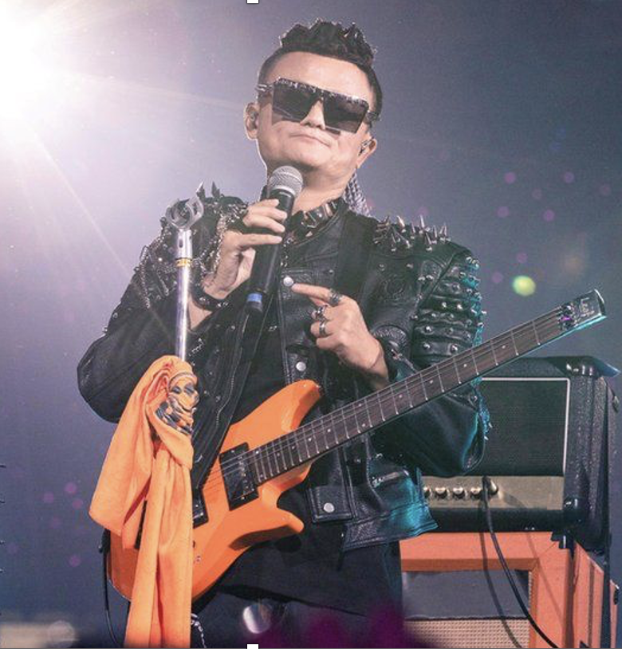
Guodong (Gordon) Gao
B.S. Electrical Engineering, B.A. Economics
MBA from Tsinghua- MIT Sloan
Worked for Compaq
PhD Information Systems and Economics, Wharton 2005
Joined U. of Maryland in 2005
Joined Hopkins in 2022
Co-Director of The Center for Digital Health and AI (CDHAI)
Still curious
https://carey.jhu.edu/faculty/gordon-gao-phd

Slide 3

https://carey.jhu.edu/cdhai

Slide 4
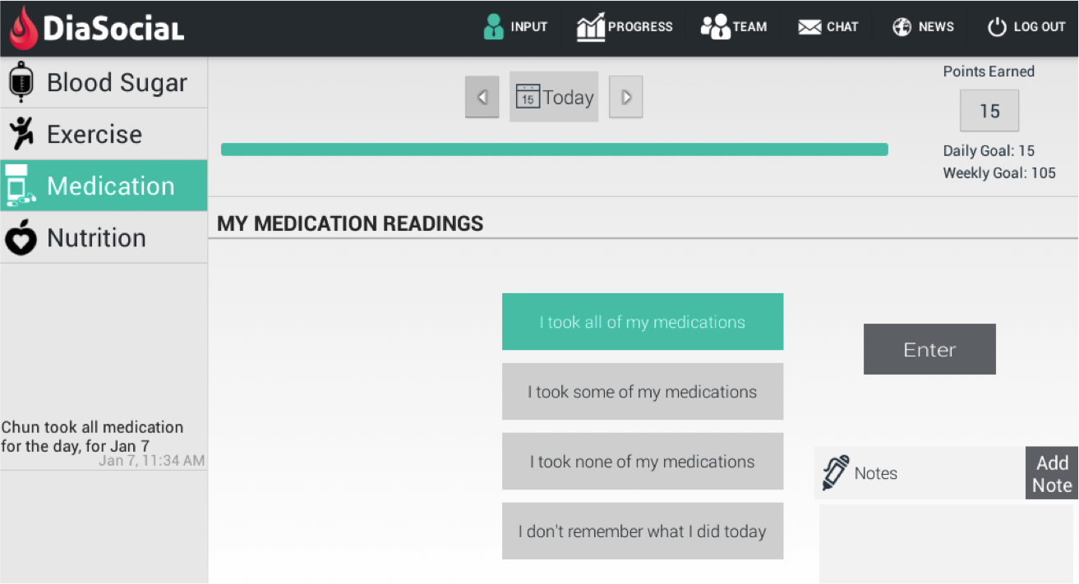
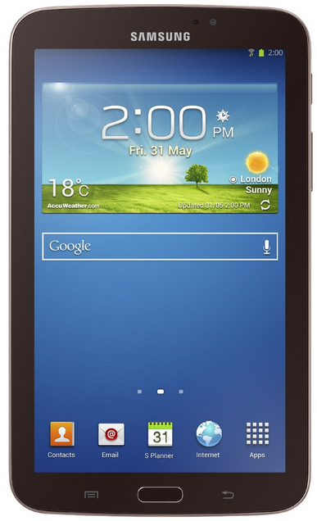

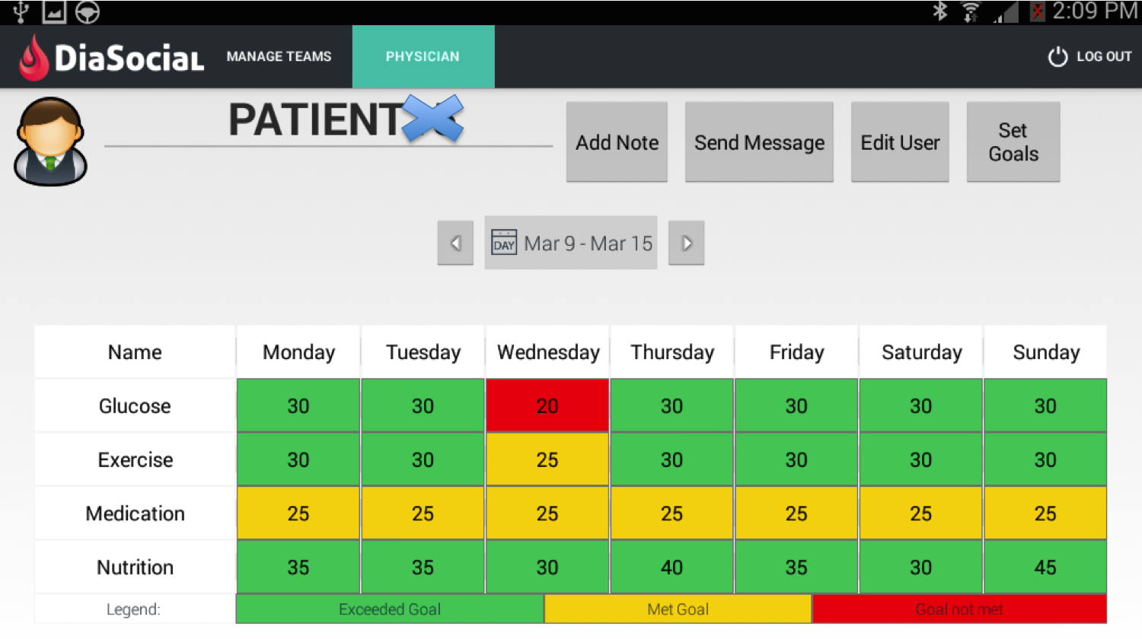
DiaSocial App
27-patient pilot in 2015, with VA Baltimore
User comments
“I used it to do the input on the medications, the exercise I did, and my food intake for my 3 meals. I got to the place where it was like second nature to want to put it in, and it worked out nice.”
“Well previously I wasn’t really managing well, this tool has been helping me. This thing can go on for another year as far as I’m concerned.”

Slide 5
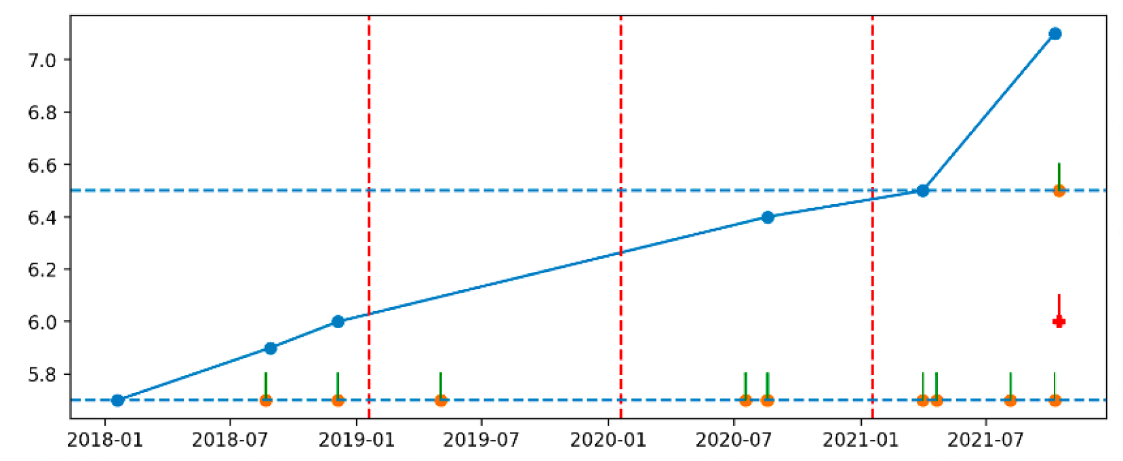




Predict the change rate of A1C
Encounters after 1st PD a1c
time
Y Definition:
Risk / Diabetic Or Not
A1C
1Y
2Y
3Y
Diabetes diagnosis (ICD E11)
Diabetes Medication
1st PD A1C
Prediabetes diagnosis (ICD R73)

Slide 6
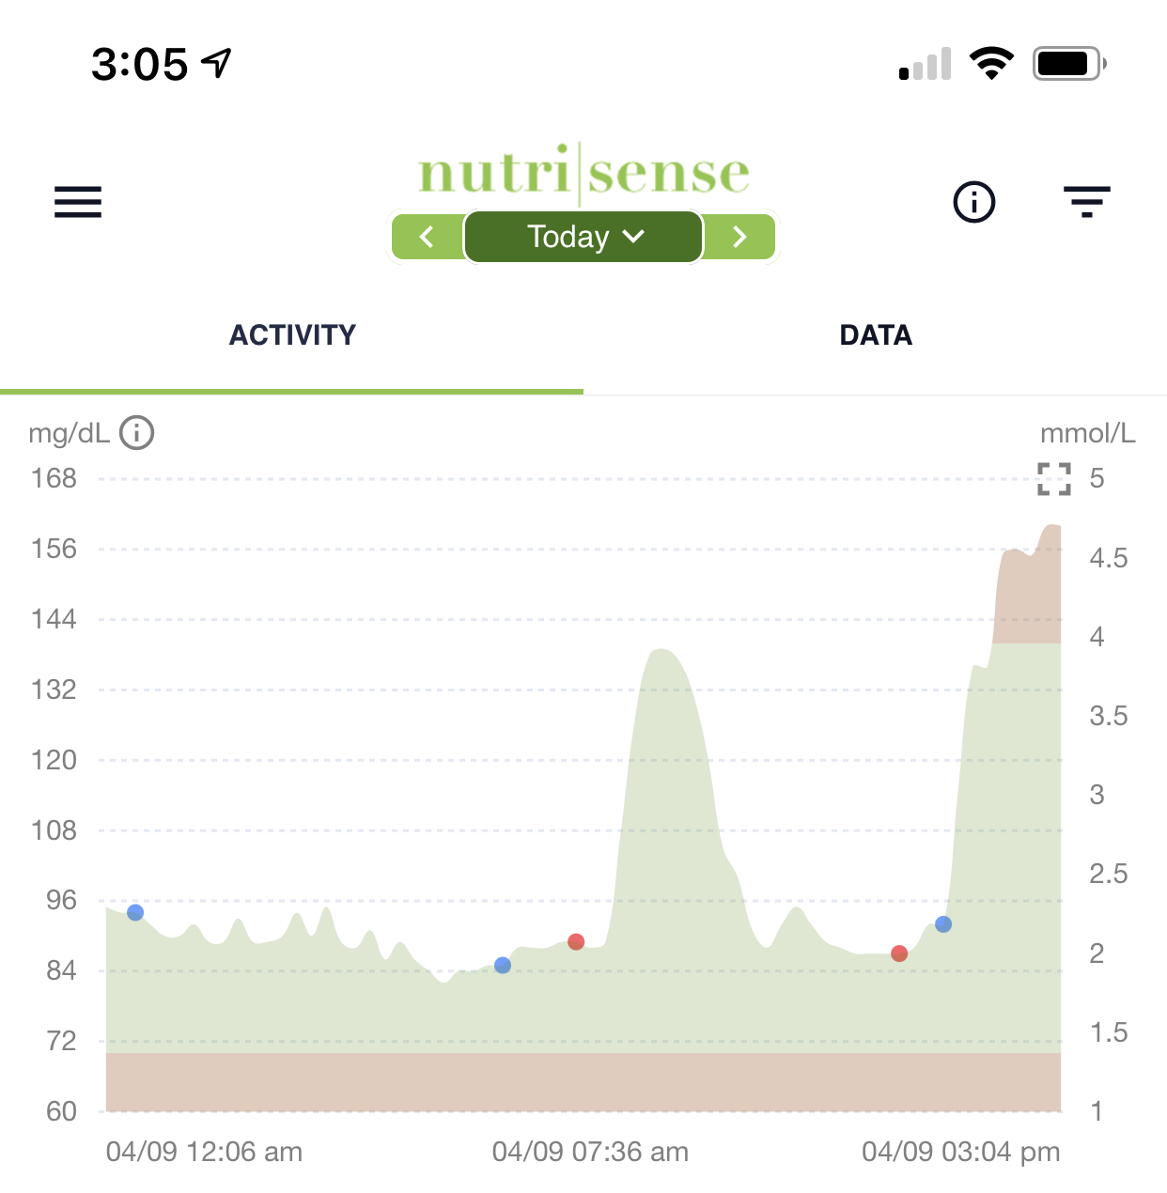
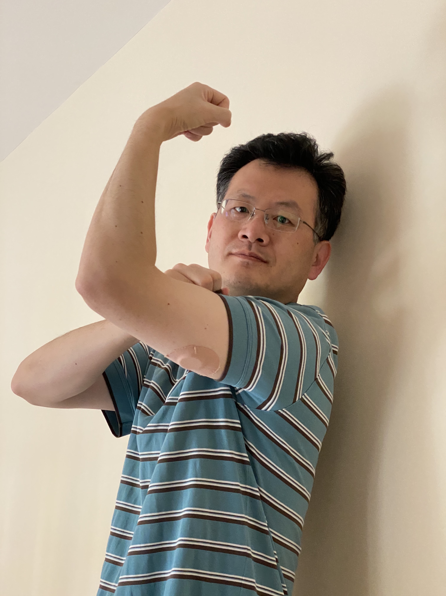

CGM devices

Slide 7
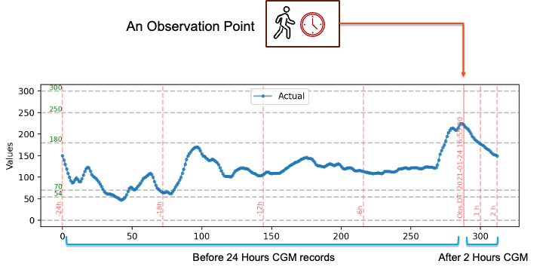
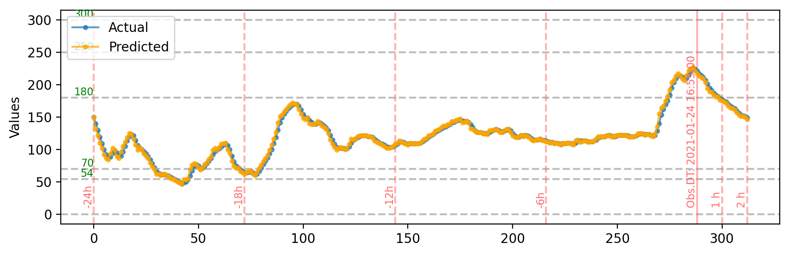
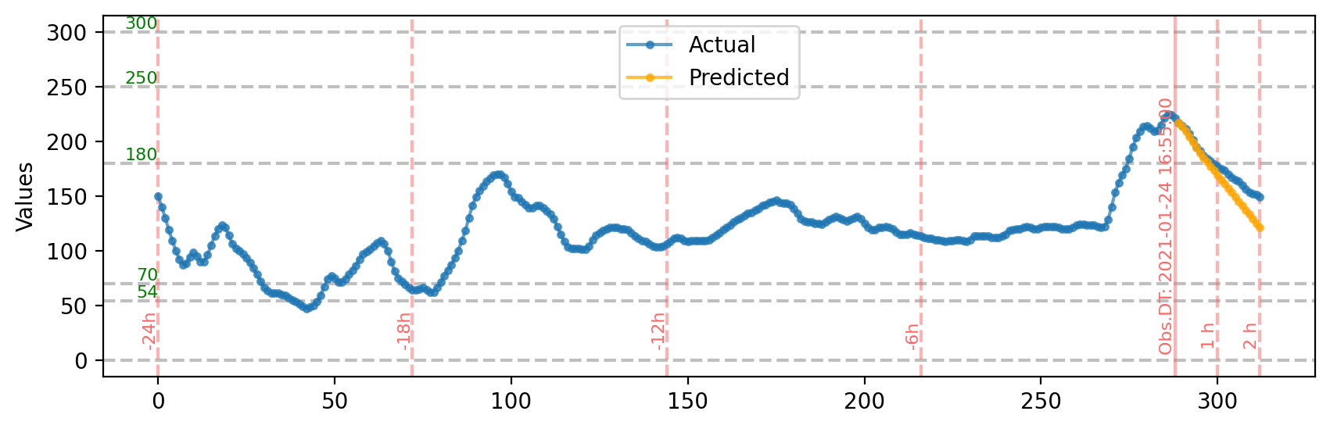

Foundation Models for Continuous Glucose Monitoring
Pretraining
Prediction
Large Sensor Model (LSM): Introduce large foundation models to human glucose sensor data to predict future glucose levels.

Slide 8
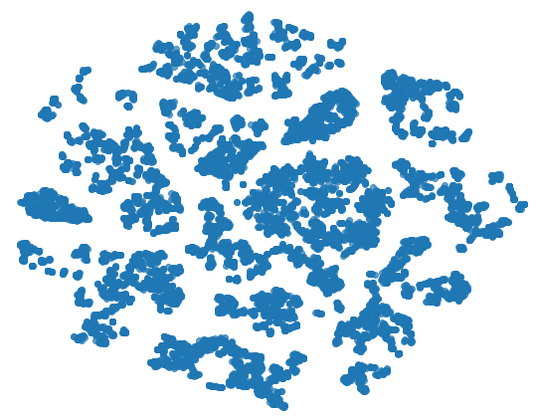
Predict ideal calling times and optimize calling sequence to improve reach rate within capacity constraints
Member Phone Call History
Graph Generation
(based on Member Similarity)
Deep Learning Prediction
Hourly Reachability
Optimal Call Sequence
Member Features
Capacity Constraints
The similarity between member and member is calculated based on their phone call history and features
100
75
The member embeddings extracted from the graph can effectively subdivide members (blue dots) into different subgroups
AverageSim:0.85
50
25
AverageSim:0.92
AverageSim:0.79
AverageSim:0.56
0
-25
-50
AverageSim:0.43
-75
-100
-100
-75
-50
-25
0
25
50
75
100

Slide 9
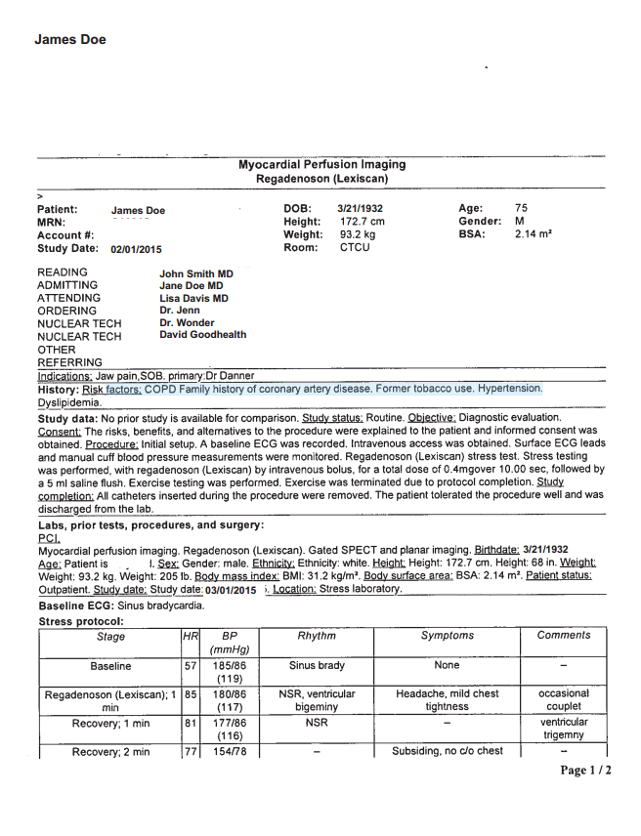
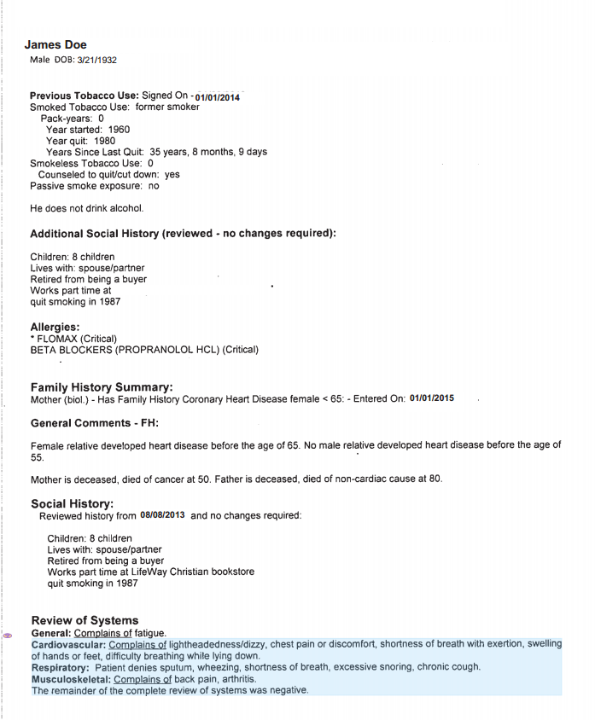
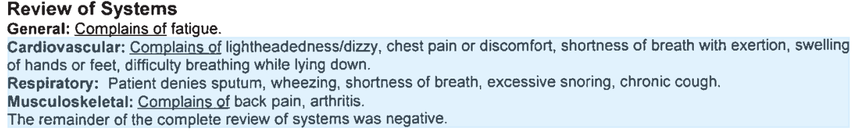
HCC 111
HCC 40
Notes:
??
Chronic obstructive pulmonary disease (COPD): https://www.ncbi.nlm.nih.gov/pmc/articles/PMC6514430/
Arthritis: https://provider.healthalliance.org/coding-counts-post/hcc-40-rheumatoid-arthritis/

Slide 10
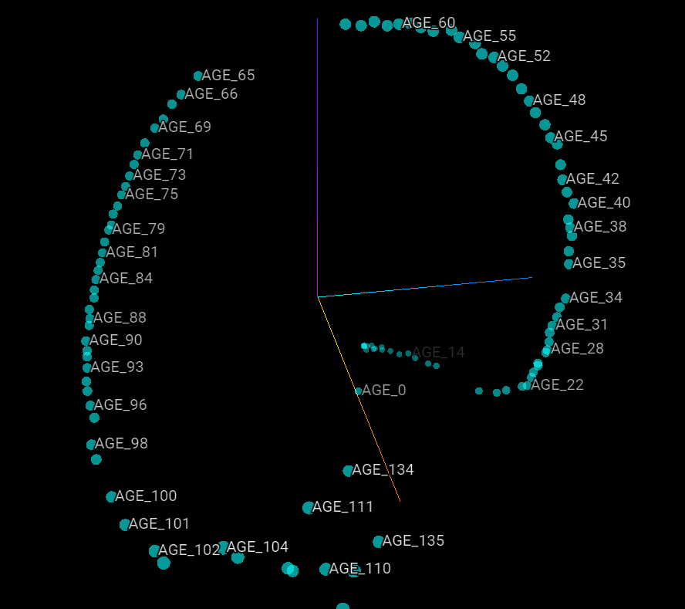

Slide 11
How AI can assist doctors
(Augmenting Physicians with Artificial Intelligence to Transform Healthcare:
Challenges and Opportunities. Agarwal, Dugas, and Gao, 2024, JEMS)
Information-related Challenges
Susceptibility to Cognitive and Social Biases
Difficulty Interpreting Patient Preferences and Values
Excessive Workload and Burnout
★ Voluminous existing Information in patient records and lab results
★ Lack of pertinent information
★ Overwhelming new knowledge
★ Cognitive Bias
e.g., Overconfidence, framing effect, availability heuristics, default choice.
★ Social Bias
e.g., Prejudice related to race and/or socioeconomic status
★ Ignore small probabilities of negative outcomes and exhibit overconfidence
★ Overemphasis on low likelihood events resulting in unnecessary testing
★ Difficult to tradeoff treatment outcome and quality of life from patient’s preference
★ Prevalence of burnout and fatigue
★ Overworked and disconnected from patients
★ Burnout causes greater turnover
★ Patient-provider communication requires emotional labor
Clinician Limitations
AI
Augmentation
☑️ Consistent AI decisions
☑️ Fair AI for unbiased decisions
☑️ AI Intervention to protect physicians from making biased decisions
☑️ Assess personal risk for focal disease
☑️ Assess risk between treatment and disease
☑️ Infer patient preference based on behavior data
☑️ AI automates repetitive and lower-skill tasks
☑️ AI detects provider’s fatigue status
☑️ AI provides real-time reminders and Interventions
☑️ Distill information
☑️ Improve alert systems
☑️ Expand data sources

Slide 12
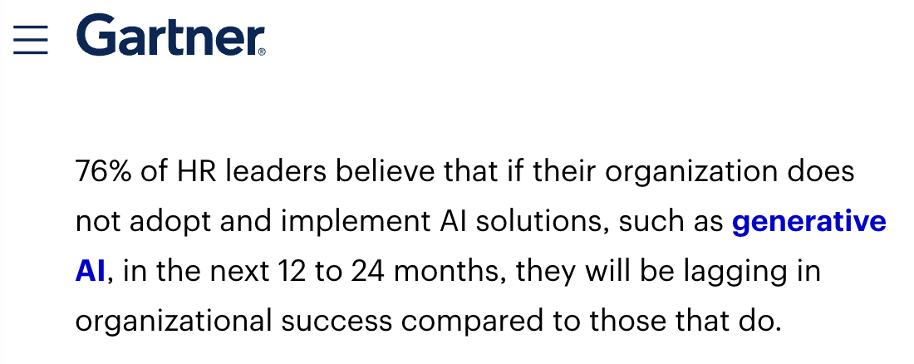
Notes:
https://www.gartner.com/en/human-resources/topics/artificial-intelligence-in-hr

Slide 13


Slide 14
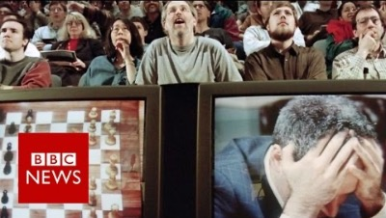
Modeling the World - 1997
Notes:
play till 2:33

Slide 15
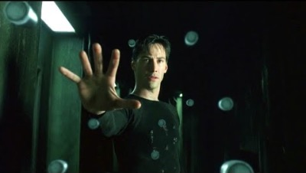
Notes:
Computer sees it in slow motion

Slide 16
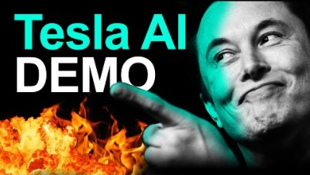
Notes:
19:50 to 20:36

Slide 17
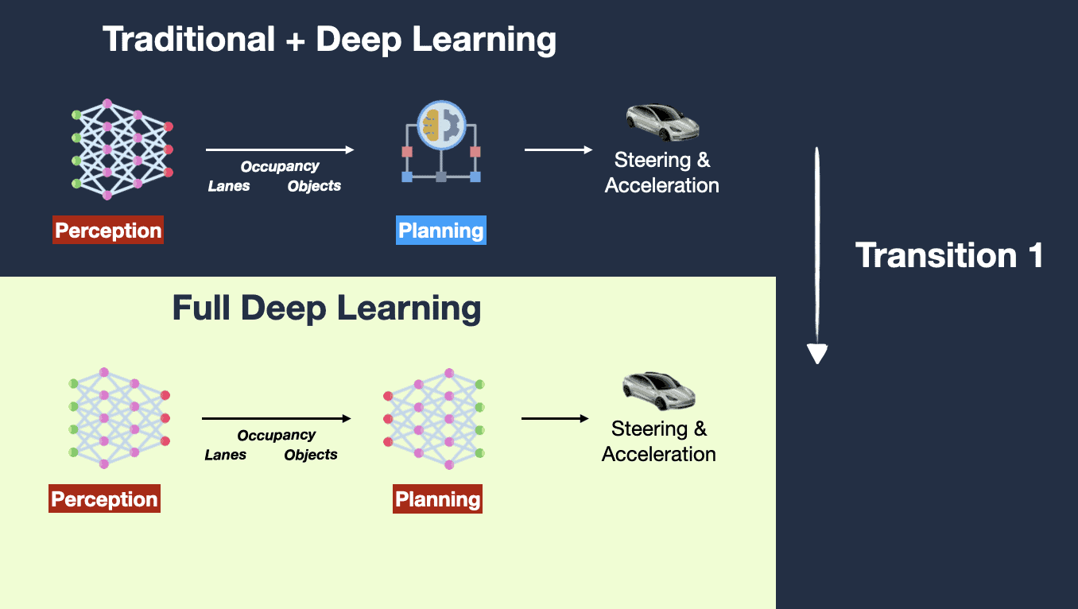
2022/2023

Slide 18
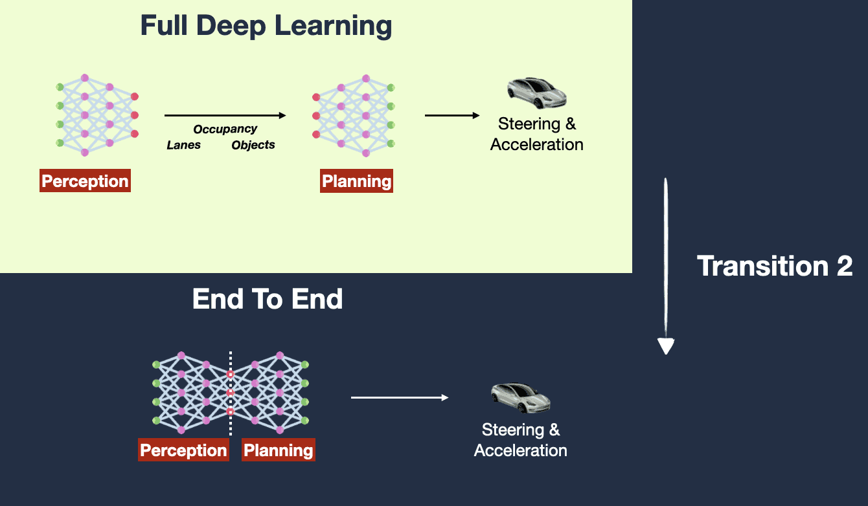
2023/2024
Notes:
December 2022, Tesla Headquarters, Palo Alto... During a meeting, an Autopilot Engineer named Dhaval Shroff pitched a new idea to Elon Musk:
💡
"It's like Chat-GPT, but for cars!!!" "Instead of determining the proper path of the car based on rules, we determine the car's proper path by using neural network that learns from millions of training examples of what humans have done."
Convinced, Elon Musk and the entire Autopilot team rushed into applying a new algorithm to the next FSD Version (from FSD v11 to FSD v12).
And that was the beginning of End-To-End Learning at Tesla...

Slide 19

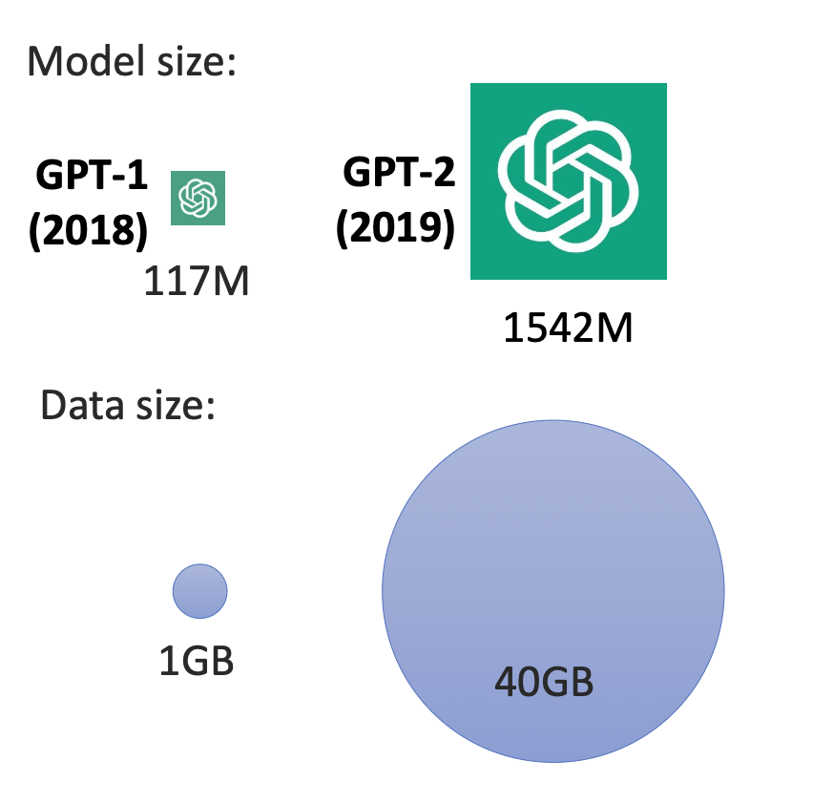
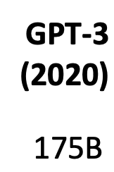

Training data size
x 180,000
45 TB RAW Textural Data
(570GB after cleaning up)
Notes:
The training dataset for GPT-3 is estimated to contain approximately 570 GB of deduplicated text data after preprocessing, though the raw data sourced for training was much larger (around 45 TB).
Here’s how this works:
1. Raw Data (45 TB):
• This includes all the unprocessed data scraped from sources like Common Crawl, books, articles, and more.
• Many parts of this dataset are duplicates or irrelevant content, which are filtered out during preprocessing.
2. Processed Data (570 GB):
• After cleaning, deduplication, and tokenization, the final dataset used to train GPT-3 shrinks significantly to about 570 GB.
• It includes high-quality text from diverse domains to ensure broad language understanding.
3. Number of Tokens:
• The 570 GB of data corresponds to around 300 billion tokens, where a token can be as short as a character or as long as a word, depending on the language.
This 570 GB of high-quality, diverse text data is what powers GPT-3’s ability to generate coherent, contextually aware responses.

Slide 20
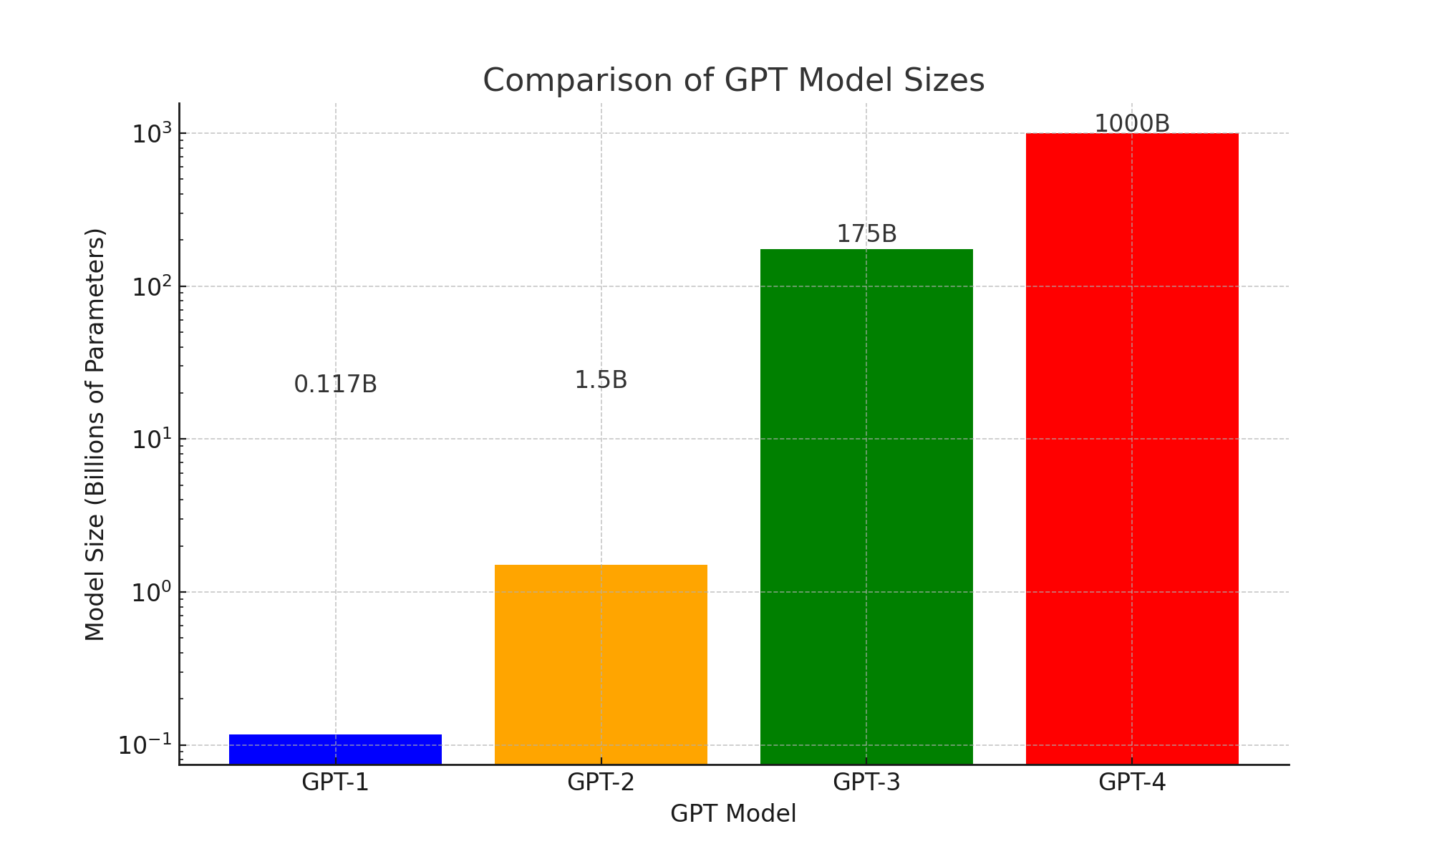
2018
2019
2020
2023

Slide 21
Quiz
Over the last 18 months, the cost of GPT-4 equivalent intelligence from OpenAI has fallen by about how much?
A. 2x
B. 10x
C. 50x
D. 250x
Notes:
https://www.wing.vc/content/plummeting-cost-ai-intelligence
which has fallen 240x in the last 18 months, from $180 per million tokens to less than $1.
Input + output cost = 6.25 / 1M input tokens
$1.25 / 1M input tokens
$5.00 / 1M output tokens

Slide 22
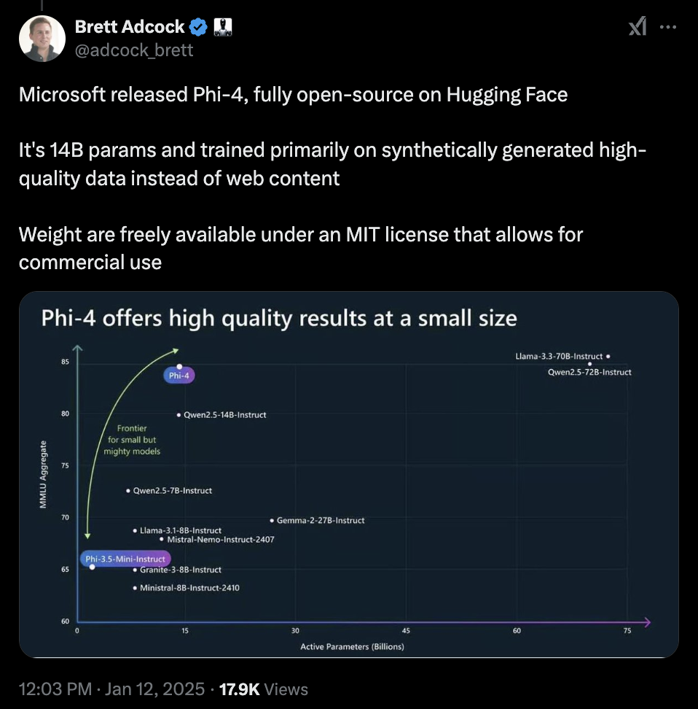




Weight and parameters
CEO of Figure AI

Slide 23
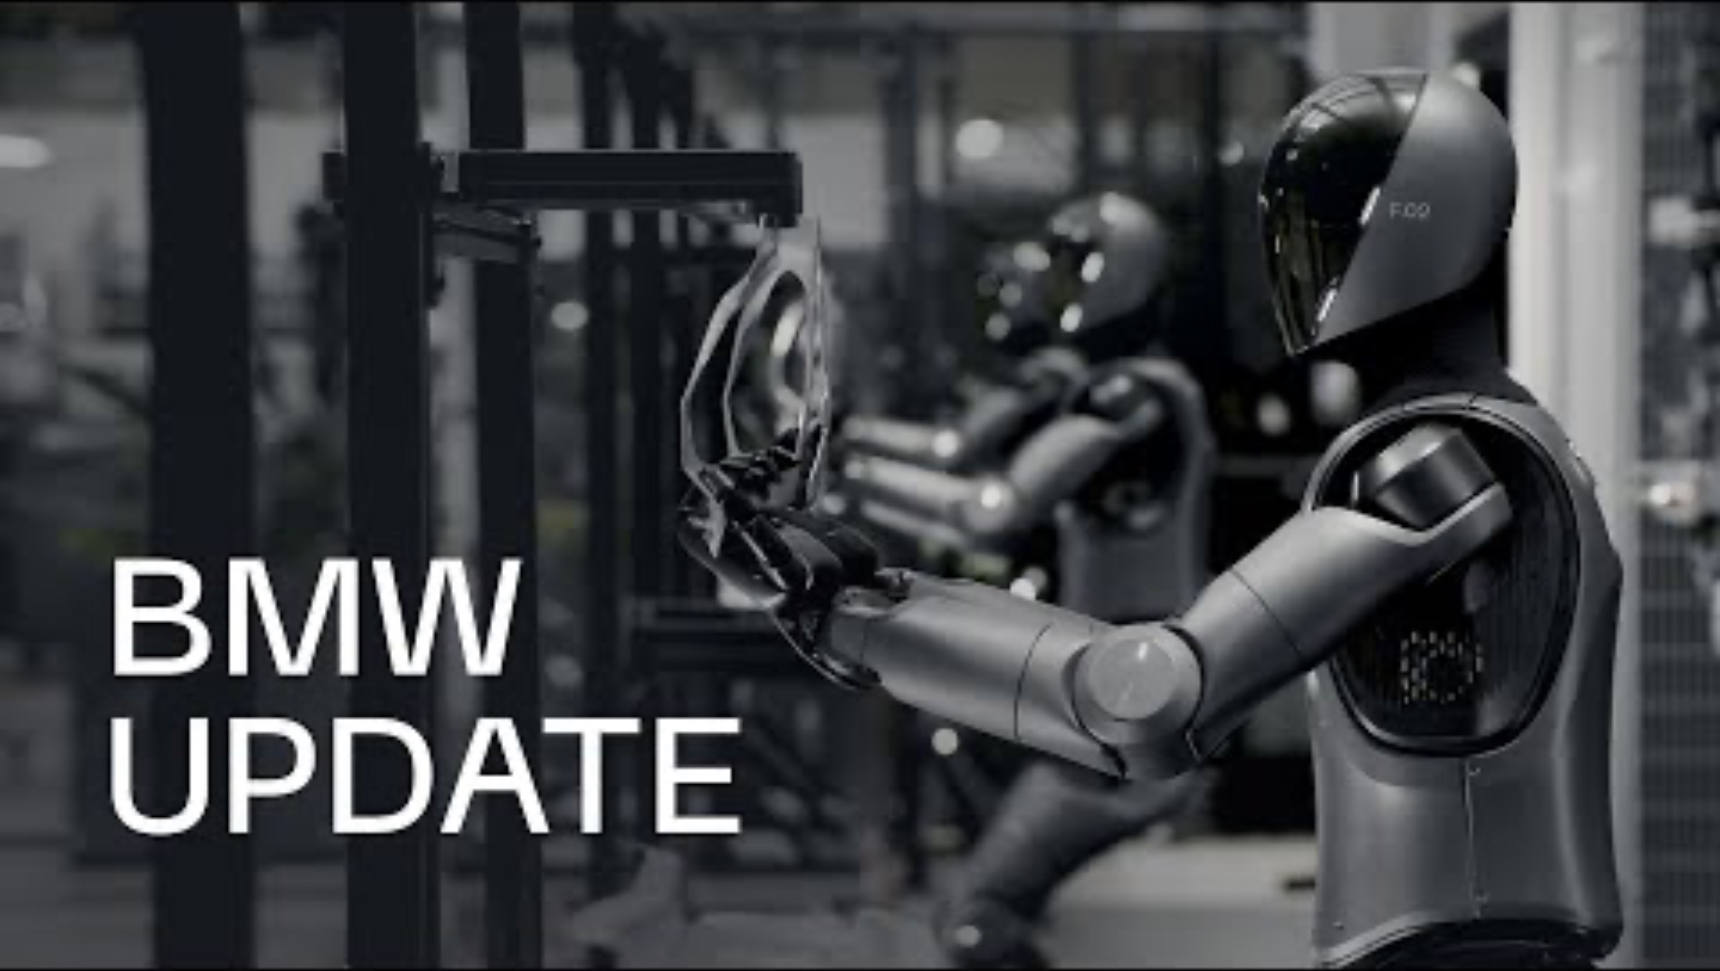

Slide 24
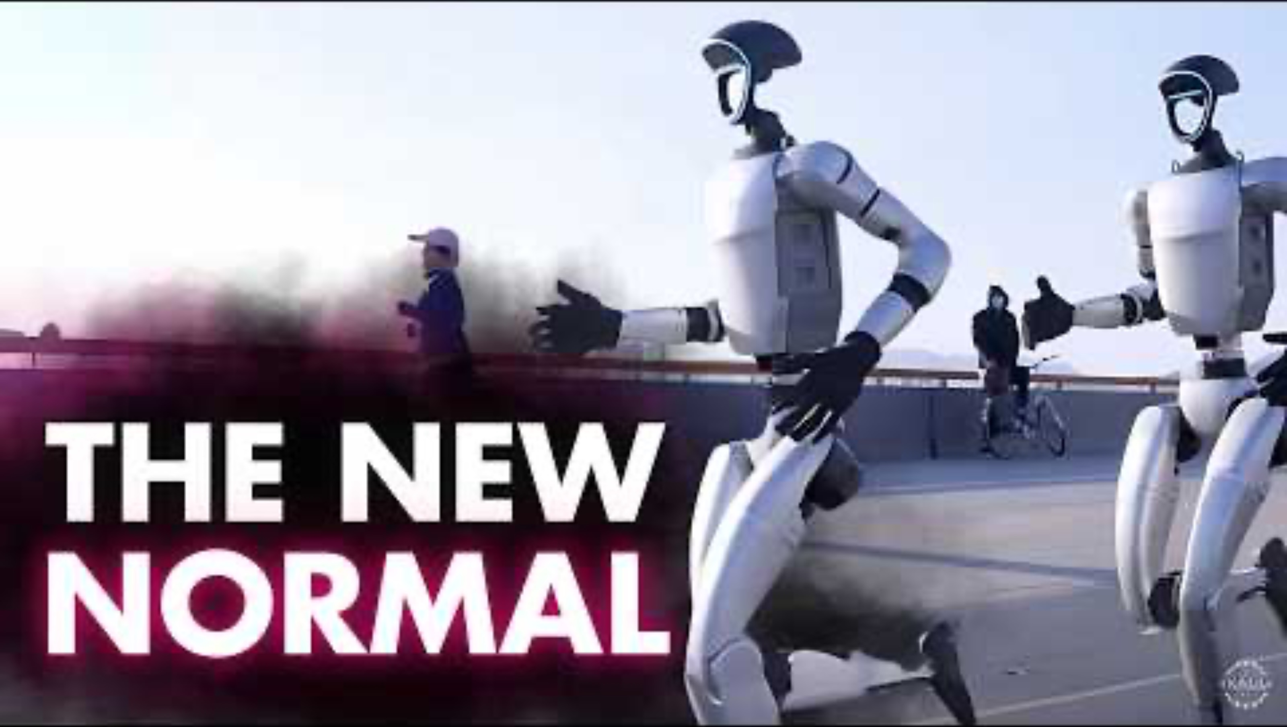

Slide 25
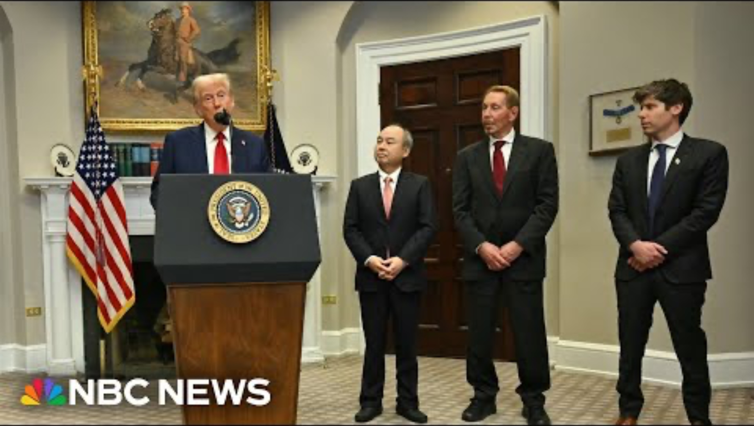

Slide 26
Two-year Anniversary of ChatGPT
Advanced Voice Mode
Voice and Image Capabilities Subscription
GPT-4o
Nov
May
2024
ChatGPT plugins
GPT-3.5/4 with browsing
iOS App Launch
Sep
ChatGPT Plus
Subscription
Jul
1 Million
Users in 5 Days
100 Million
Monthly Users
Apr
2023
May
Feb
Jan
O1 Model Launch
Dec 5
Aug
2022
May
ChatGPT Enterprise Launch
Mar
iOS App Launch
GPT-4 Release
Nov 30
Launch of ChatGPT

Slide 27
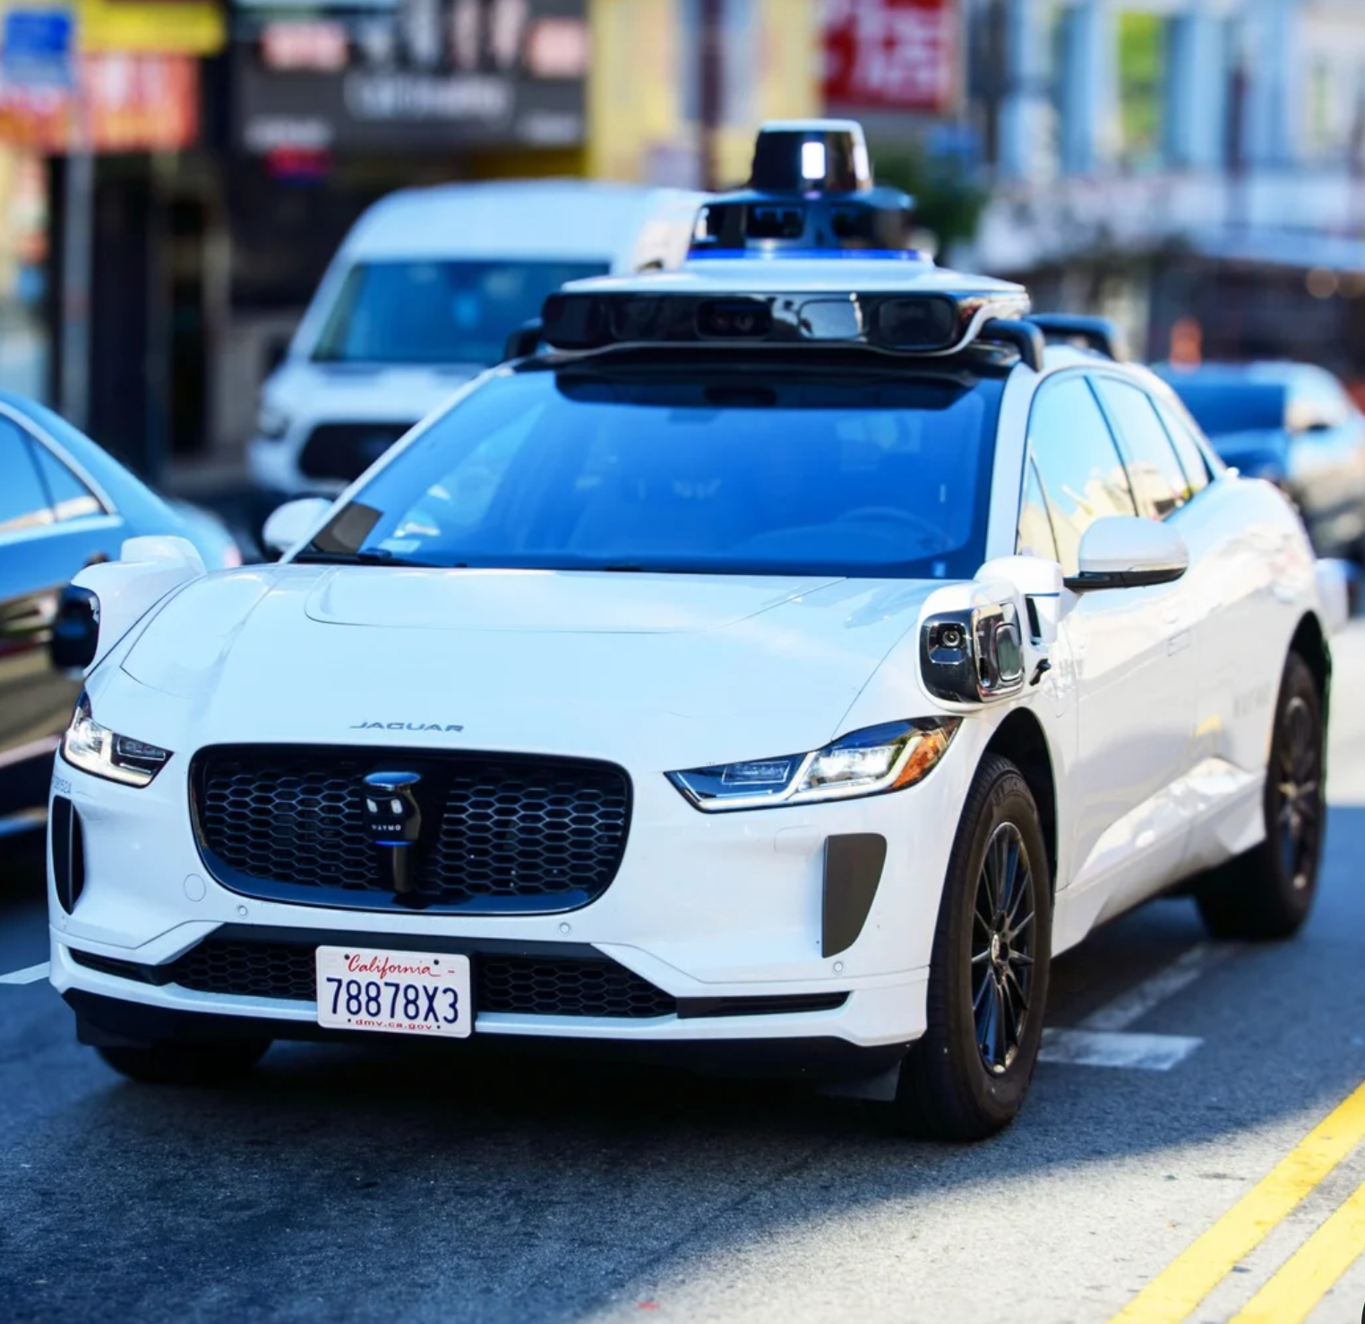
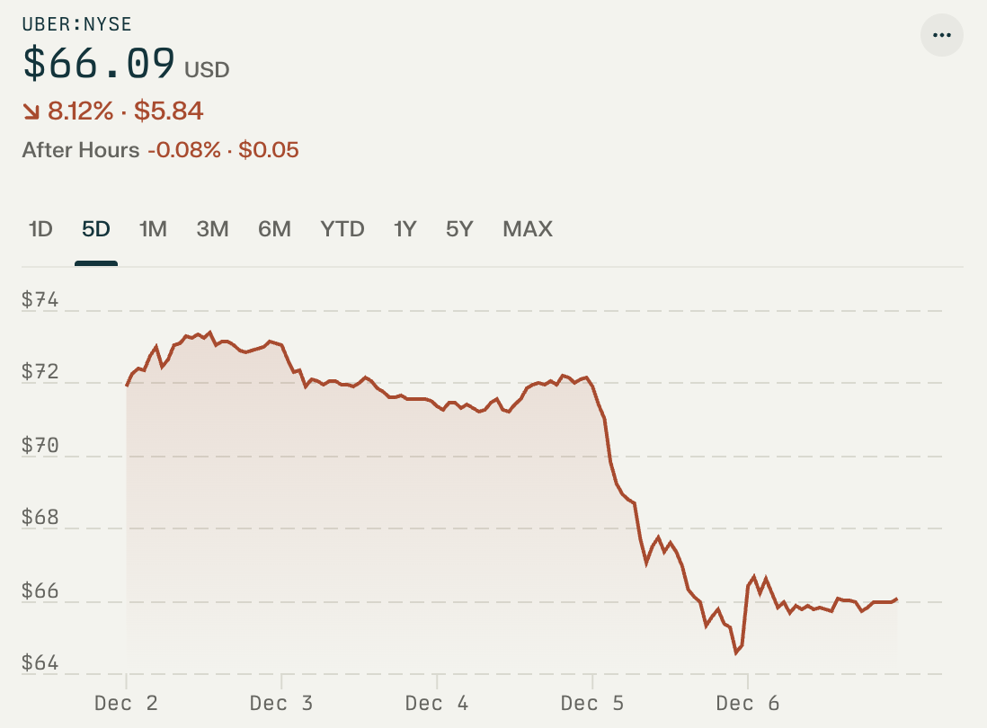
Uber price dropped by 6% in a day – why?
Notes:
https://finance.yahoo.com/news/uber-lyft-stocks-plunge-googles-214919483.html?guccounter=1&guce_referrer=aHR0cHM6Ly93d3cuZ29vZ2xlLmNvbS8&guce_referrer_sig=AQAAANiRkre5_w545Qxoyr3xDLwKPEXw7CLDNnwFOUAwsjhrMtDPL2g4WBjx7pcdOOX96OIUqs9HCB1EwfOlXjakaz_gFjd3_vRMwWans-2Em5mNux-lknKEEMTmsFF15KoVI08MJp0s5yZJFmnzP_YiKZcLyb-7Th_I8pNwZHJEdOgJ
The Alphabet-owned company announced Thursday that it will be hitting the roads in Miami. Waymo said it will first begin cruising through the Florida city with human safety drivers in 2025 before opening doors to riders for its robotaxi service through its Waymo One app in 2026.

Slide 28

Notes:
https://www.nationalnursesunited.org/press/cna-demand-patient-safeguards-against-artificial-intelligence
On Monday, April 22, hundreds of registered nurses and members of California Nurses Association (CNA) from across the state will hold a protest at Kaiser Permanente (KP)’s San Francisco Medical Center to highlight their patient safety concerns about artificial intelligence (AI) technology and the hospital industry’s rush to implement untested and unregulated AI.

Slide 29


Impact on the labor force
The technology could bring about "12 million occupational transitions" by 2030, according to Kweilin Ellingrud, a McKinsey partner.
In 2023, Goldman Sachs produced a report speculating that AI could replace the equivalent of up to 300 million jobs — namely in the administrative sector.
Notes:
https://www.businessinsider.com/jensen-huang-nvidia-ai-jobs-replace-summit-mumbai-2024-10
https://www.bbc.com/news/technology-65102150

Slide 30
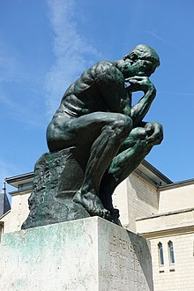
Disambiguating AI: Open questions
What is the nature of AI?
What is AI good for?
How do we ensure AI use is fair and ethical?
How can workers and companies be more productive with AI?
How can I be even more valuable with AI?
How to ensure my position is not eliminated by AI?
How can I be a leader in transforming my organization using AI?

Slide 31


Timeline of GPT models
GPT-4,
GPT-4o,
GPT-4o mini
o1
GPT-3, GPT-3.5
GPT-2
The Latest advancements in technology.
higher intelligence and optimized processing capabilities
GPT-1
Highly sophisticated, multimodal capabilities, deeper contextual comprehension.
Advanced complexity, broader knowledge, more nuanced responses.
Larger scale, more diverse language understanding and generation.
Early model, simple, basic language abilities.
2024
2023
2021
2019
2018

Slide 32
What is GPT?

Slide 33
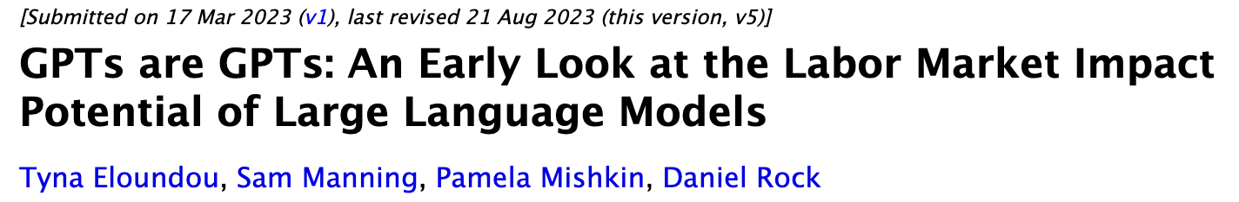
GPTs are GPTs
arXiv:2303.10130
GPT: Generative Pre-trained Transformer
GPT: General Purpose Technology
Notes:
Can you name a recent general purpose technology? Steam Engine and Steam Power (18th-19th century)
Revolutionized manufacturing and transportation
Enabled mechanized production and railways
Electricity (Late 19th-20th century)
Transformed both industrial production and daily life
Enabled countless other technologies and innovations
Internet

Slide 34

34

Slide 35
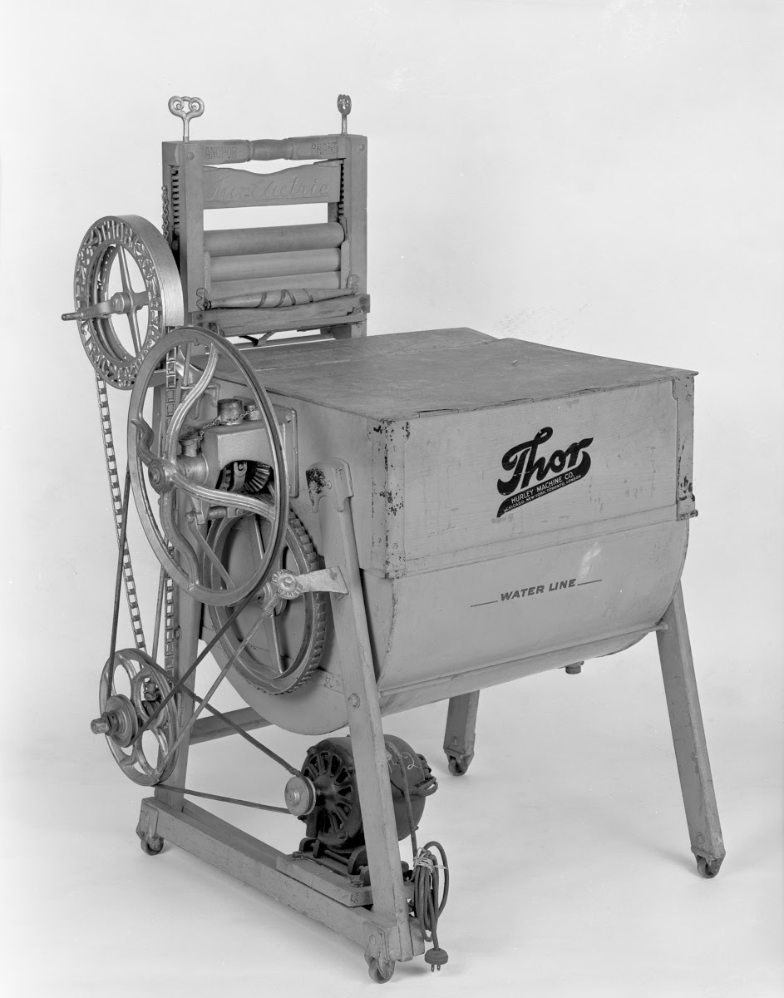
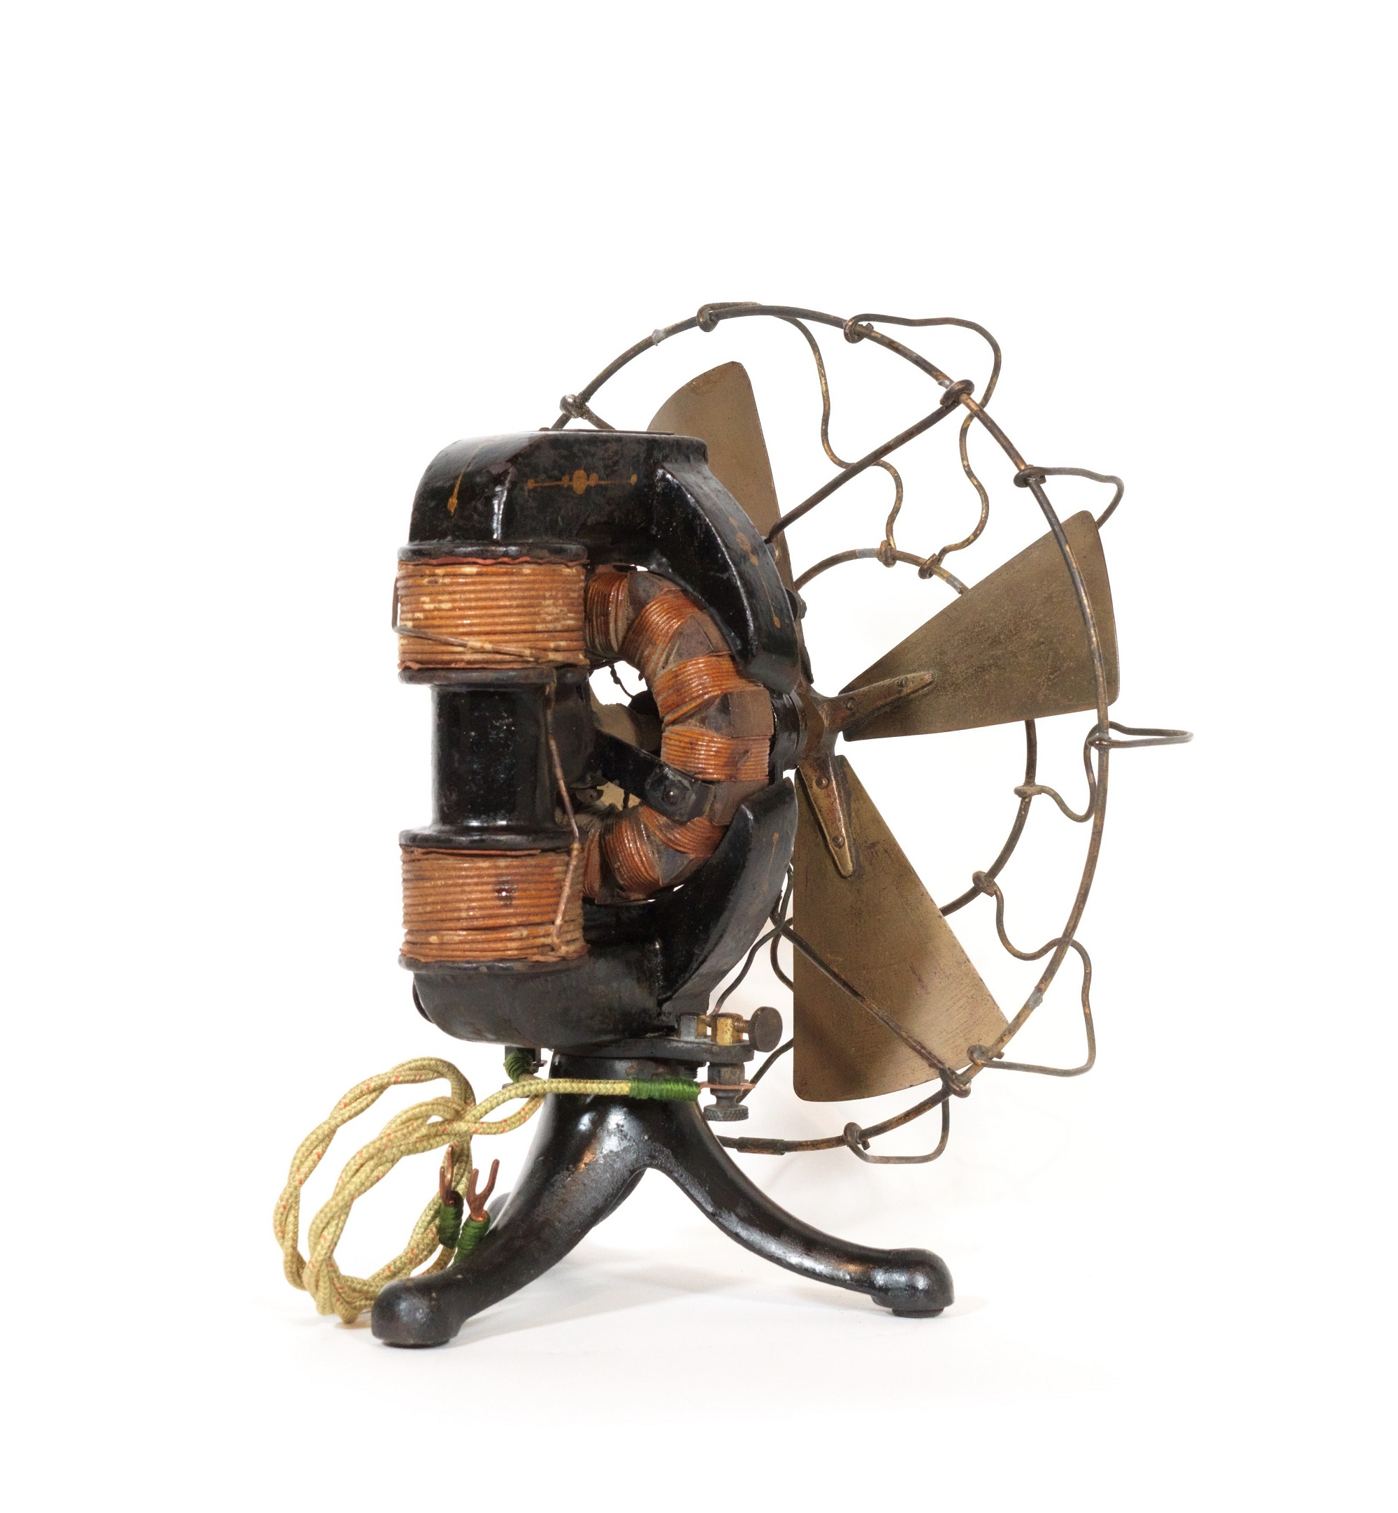
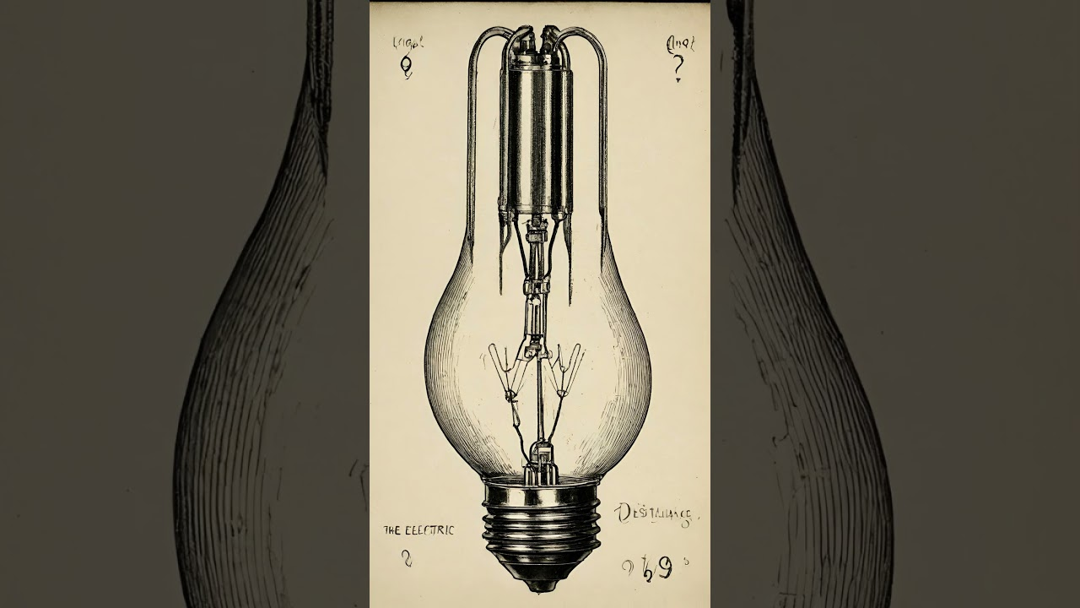
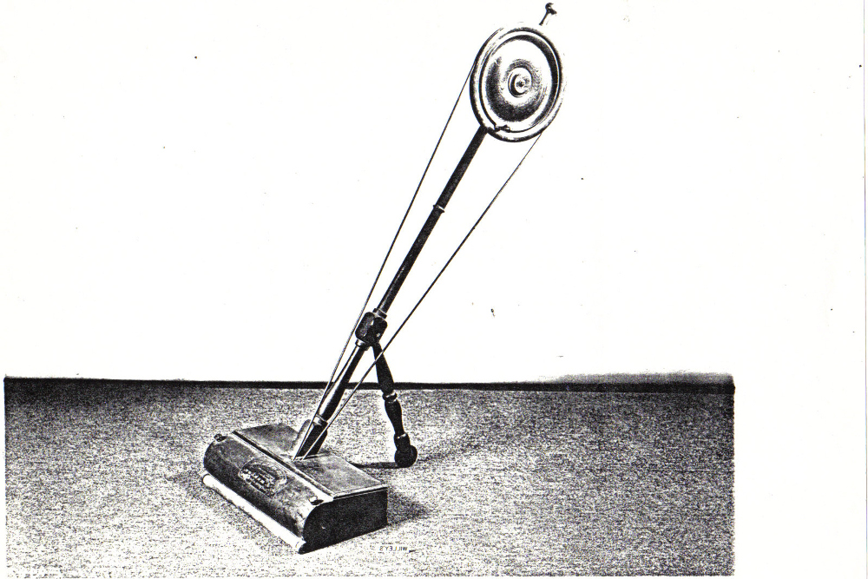
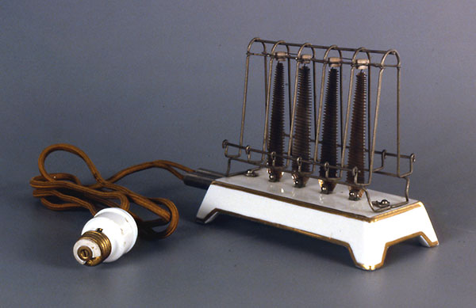
Electricity’s Journey as GPT: The Golden Age
Light Bulb（1879）
First Killer app that wired the world
Electric fan(1890)
Golden age to appliances starts
Vacuum cleaner(1905)
Weighted 92 pounds
Washing Machine (1910)
Everyone wants it
But it’s dangerous
Toaster(1912)
a huge success
The Big question:
We have electricity now, what will be the light bulb, the electric fan, the vacuum cleaner, the toaster, the washing machine in our time?
History doesn't repeat itself, but it often rhymes
-Mark Twain
Notes:
Use of electricity , electricity can use for different kinds of machine
They were not putting electricity at home, they were putting light bulb at home
From here, we are more and more prosperous

Slide 36
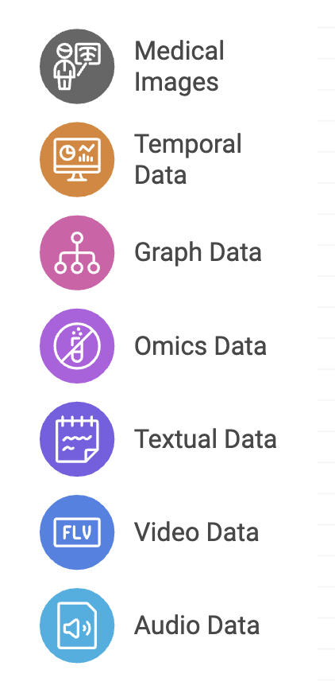
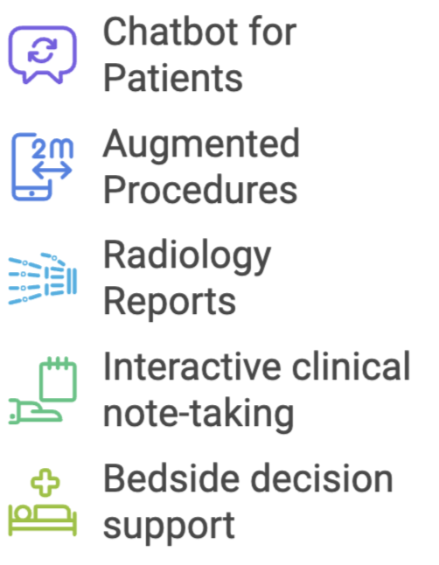
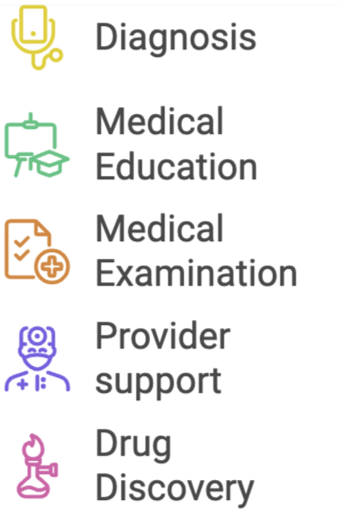





Potential: Help with all kinds of problems
Data Modality
Generative AI
Applications
Notes:
I want to create a figure shows the multi-modality healthcare data, including medical images, temporal data, graph data, omics data, textual data, video, and audio data.

Slide 37
We need critical thinking in AI

Slide 38
Goals of this course
Equip you with the essential technology foundation to be comfortable and confident with AI
How Neural Net works, training process
CNN, RNN, LSTM, Transformer, Attention, LLM
ChatGPT, Prompt Engineering, RAG, Agentic AI
AI vs Human
Equip you with the essential business knowledge of AI
What it is good for, what it is NOT good for
How to identify opportunities enabled by AI
How to form AI strategy for business

Slide 39

















Slide 40


















Slide 41

























Slide 42


AI…
Google Colab
Keras

Slide 43
We are doing cutting-edge stuff
Technology is evolving really fast
Hadoop 1.0 -> 2.0 -> 2.6 -> 2.7->3.0->3.1
Spark ->1.0->2.0->2.3
GPT 3 ->3.5->4->4o -> o1 ->o3
It is not the old RDBMS (40+ years of development)
It is not the classical machine learning
(but many concepts/skills you learned there will be very helpful)
Expect the road to be a bit bumpy

Slide 44

But hopefully the experience will be very rewarding

Slide 45
Course structure
Lectures
Assignments
Quizzes
Projects

